Slide 1


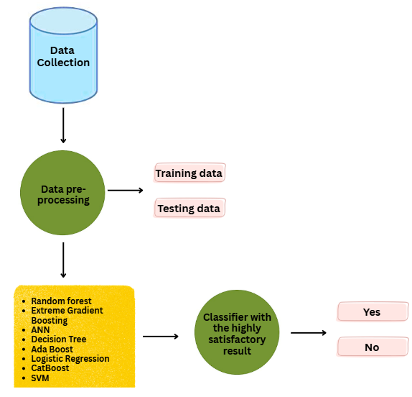
Faculty of Applied Science
University of Vavuniya
Comparative Study of Machine Learning Models for Non-Communicable Disease Prediction
Author Name1^{1*}, Author Name2², Author Name3¹
¹Affliation 1, ²Affliation2
Abstract
Introduction
Objective
Morbidity and mortality matters Cardiovascular and other non-communicable diseases (NCDs), including diabetes and cancers, are global leading causes of morbidity and mortality globally. This analysis draws on the techniques of supervised machine learning (ML) models to predict the risks of NCDs based on anthropometric data drawn from 300 participants in the Jaffna Teaching Hospital and Sabaragamuwa University in Sri Lanka. Preprocessing of data was done through eliminating noise, normalization, and correction of outliers. Such models as Random Forest, XGBoost, ANN, Decision Tree, AdaBoost, Logistic Regression, CatBoost, and SVM were trained and optimized over a grid search cross-validation. The findings present that Random Forest reported the best accuracy (98.9), whereas ensemble models were superior to other conventional classifiers. The method offers a suitable instrument in the timely detection of NCDs that facilitate preventive care where resources are scarce.
Non-communicable diseases (NCDs) cause more than 70% of deaths worldwide. Early detection and prediction are crucial for prevention. Machine learning has shown promise in predictive healthcare, offering cost-effective, data-driven solutions. This study investigates ML models applied to anthropometric data to predict NCD risk in Sri Lanka.
To preprocess and analyze anthropometric data for NCD risk prediction.
To evaluate and compare the performance of multiple supervised ML algorithms.
To identify the most effective model for early detection of NCDs.
Results
Methodology
Table 1: Algorithm’s accuracy, mean squared error and absolute squared error
Algorithms | Accuracy (%) | Mean Squared Error [MSE] (%) | Absolute Squared Error [ASE] (%)
Random Forest | 98.90 | 1.09 | 1.09
Extreme Gradient Boosting | 97.80 | 2.19 | 2.19
ANN | 97.80 | 2.19 | 2.19
Decision Tree | 96.05 | 3.94 | 3.94
Ada Boost | 93.40 | 6.59 | 6.59
Logistic Regression | 88.52 | 11.47 | 11.47
Cat Boost | 87.91 | 12.08 | 12.08
SVM | 85.24 | 14.75 | 14.75
Conclusion
Among the tested models, Random Forest emerged as the most accurate (98.9%) and reliable, followed closely by XGBoost and ANN. Traditional models such as Logistic Regression and SVM performed less effectively. These findings confirm that ensemble learning techniques can significantly enhance NCD risk prediction using simple anthropometric data. Such models provide a low-cost, scalable, and effective tool for preventive healthcare.
References
K. Tripathi and H. Garg, “Machine Learning techniques for Cardiovascular Disease” in IOP Conference Series: Materials Science and Engineering, 2021, p. 012140. R. E. Ali, H. El
Kadi, S. S. Labib, and Y. I. Saad, “Prediction of potential-diabetic obese-patients using machine learning techniques” 2019.
Figure 1: High-level architecture

